Slide 1

A Project Stage I Presentation on
Stress detection in person by image processing and Machine Learning
Under the Guidance of
MR.Chetan Patil
Presented by
Tejaswini Anil Aher(B190582001)
Vaishnavi Anil bhosale (B190582006)
Pooja Ganpat Gawali (B190582017)
Gayatri Vinod Ushir (B190582069)
Department of Artificial Intelligence & Data Science
Matoshri College of Engineering & Research Centre, Nashik
2023-2024

Slide 2

Presentation Outline
Introduction (Needs ,Problem statement,Objectives)
Literature Survey
Proposed System Architecture
Details of modules
Algorithms
Design
Software Hardware Requirements
Expected Result
References

Slide 3
Introduction
Stress detection in individuals using image processing and machine learning is a fascinating area of research and technology. This approach leverages computer vision and artificial intelligence to identify signs of stress in people based on their facial expressions and other visual cues. The system involves data collection,Facial Feature Extraction,Machine Learning Models,Learning and Training,Real -Time Application.

Slide 4
Needs
1.Early Intervention
2.Mental Health Monitoring
3. Workplace Productivity
4. Healthcare
5. Improving Quality of Life

Slide 5
Problem statement
The problem definition for a stress detection project is to develop a system or technology that can accurately identify and measure the level of stress in individuals based on various physiological and behavioral cues, such as heart rate, skin conductance, facial expressions, speech patterns, or other relevant indicators.

Slide 6
Objectives
• The objective of a stress detection project is to develop a system or method that can accurately identify and quantify stress levels in individuals, typically through physiological, behavioral, or psychological indicators.
• To identify the impact of depression and other serious mental illnesses
• To increase awareness of the prevalence and consequences of untreated depression in the older adult.
• To define mood and affect.

Slide 7
Literature Survey
Sr No | Name of paper | Author name | Year
1 | A Summarization of the Visual Depression Databases for Depression Detection | Arselan Ashraf; Teddy Surya Gunawan;Farah DiyanaAbdul Rahman;Mira Kartiwi | 2019 IEEE
2 | A New Method for Discovering Daily Depression from Tweets to Monitor Peoples Depression Status | Sudha Tushara Sadasiv uni; Yan qing Zhang | 2020 IEEE
3 | Real-Time CNN Based ST Depression Episode Detection Using Single-Lead ECG | Erhan Tiryaki; Akshay Sonawane; Lak shman Tamil | 2021 IEEE

Slide 8
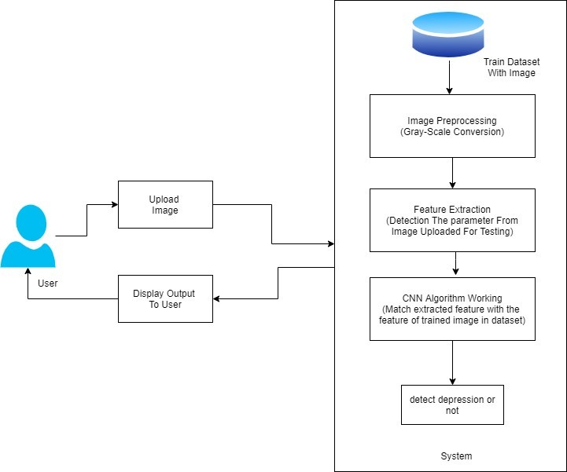
Propose System Architecture
The proposed system for facial expression-based stress detection combines the power of Convolutional Neural Networks (CNNs) and Haar Cascade for a comprehensive and accurate approach to assess stress levels based on facial expressions.
. The system begins with data collection, gathering a diverse dataset that includes image or videos of individuals displaying a range of emotions, including those associated with stress.

Slide 9
Details of Modules
Registration : Thise module Initially, fill the details to registre and creates account.
Login : Initially, users authenticate a secure login process, Once logged in, the system utilizes image processing techniques to capture and analyze facial expressions in real-time.
Training using images dataset : This module are diverse and well-curated dataset of facial images depicting various stress levels is collected.
Analysis model:This module are used for the analysis process.
Recommendation:this model displays the evolution of analysis model and gives the recommendation

Slide 10
Algorithms
1.Convolutional Neural Network
Step 1:Convolution layers: A CNN layer that performs feature extraction, which consists of a combination of linear and nonlinear operations .
Step 2:Nonlinear activation function:The outputs of a linear operation such as passed a nonlinear activation function they are commonly used rectified linear unit (ReLU).
Step 3:Pooling layer :A pooling layer provides a typical down sampling operation which reduces the in-plane dimensionality.
Step 4:Fully connected layer :: The output feature maps of the final convolution or pooling layer is typically flattened.

Slide 11
Algorithms
2.Haar Cascade Algorithm
Step 1:Haar Features Calculation: Gathering the Haar features is the first stage.
Step 2:Integral Image Creation: Creating Integral Images reduces the calculation.
Step 3:Adaboost Training: The ”weak classifiers” are combined by Adaboost Training to produce a ”strong classifier” that the object detection method can use.
Step 4:Cascading Classifiers Implementation: Every sage at this point is actually a group of inexperi-enced students.

Slide 12
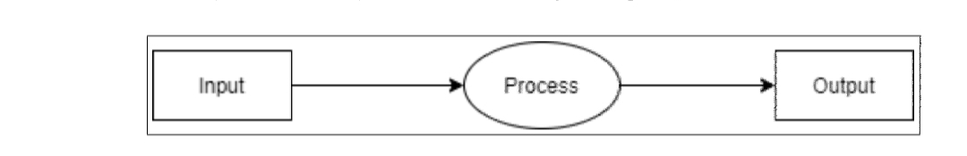
Design
1.DFD
Fig .Data flow diagram -0

Slide 13
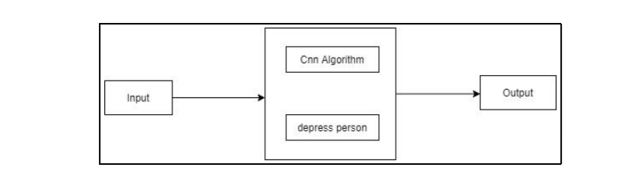
Design
2.DFD
Fig .Data flow diagram -1

Slide 14
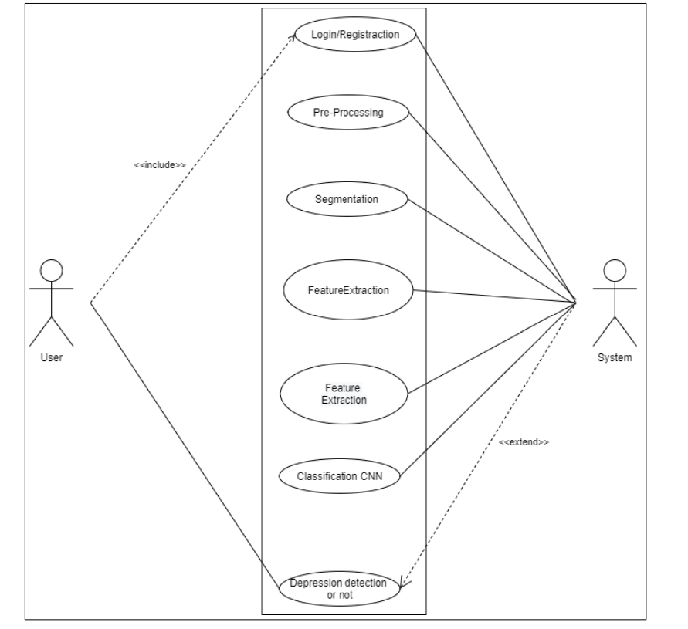
Design
3.UML
Fig .Use case digram

Slide 15
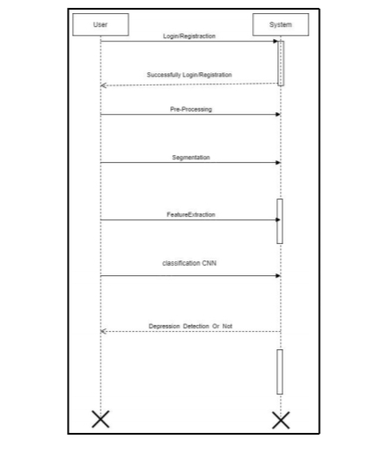
Design
4.Sequence Digram
Fig . Sequence digram

Slide 16
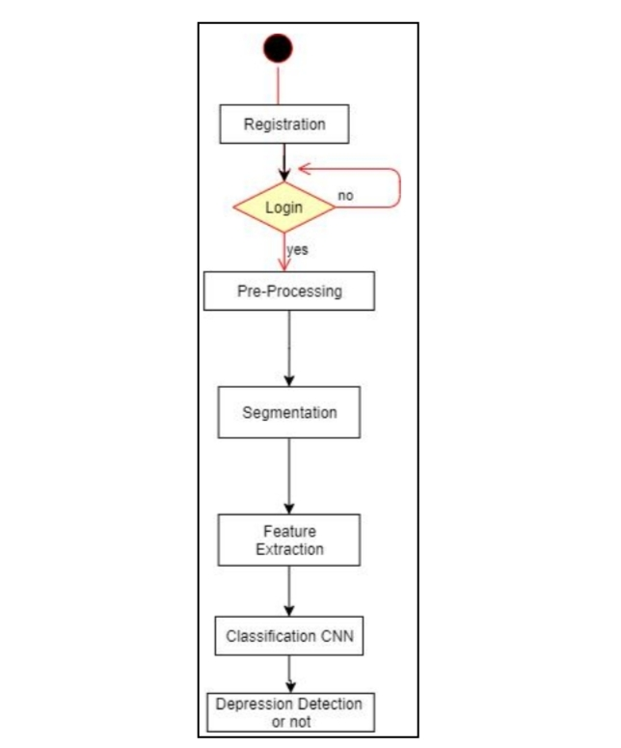
Design
5.Activity Digram
Fig . Activity Digram

Slide 17
Software & Hardware Requirements
Software requirements:
Operating system : Windows 10. Coding Language : Python IDE : Spyder Database : SQLite.
Hardware requirements:
System : Intel I5 Processor. Hard Disk : 500 GB. Ram : 8 GB

Slide 18
Applications
Mental Health Monitoring :Detecting stress through facial expressions and physiological data can assist in monitoring individuals with mental health conditions, such as anxiety disorders and depression.
Human Resources and Workplace :Employers can use stress detection to monitor employee well-being and provide support when necessary to reduce workplace stress and improve productivity.
Medical Diagnostics : Stress detection can aid in diagnosing or monitoring stress-related health conditions, such as cardiovascular diseases and hypertension.
Education and E-Learning: Stress detection can be applied in educational settings to monitor students' stress levels and offer support when needed, especially in remote learning environments.

Slide 19
Advantages
Data is collected from real-time sensors and a data set is created for different ages and male and female users.
Data is trained using machine learning which helps automate the process of stress detection.
The web applications can help users to easily check their stress state based on their features.

Slide 20
Conclusion
The live project on stress detection in individuals through image processing and machine learning has demonstrated its potential as a valuable tool in addressing the complex issue of stress. By collecting and preprocessing a diverse dataset, extracting relevant features, and employing machine learning models, particularly Convolutional Neural Networks (CNN), the project successfully classified individuals as ”stressed” or ”not stressed” based on facial and physiological cues. The real-time stress monitoring capability, powered by OpenCV, has practical applications for continuous assessment.

Slide 21
References
[1] S. A. Singh, P. K. Gupta, M. Rajeshwari, and T. Janumala, ‘‘Detection of stress using biosensors,’’ Mater. Today, vol. 5, no. 10, pp. 21003–21010, 2018. [2] J. Ogorevc, A. Podlesek, G. Geršak, and J. Drnovšek, ‘‘The effect of mental stress on psychophysiological parameters,’’ in Proc. IEEE Int. Symp. Med. Meas. Appl., Bari, Italy, May 2011, pp. 294–299.
[3] A. Fernandes, R. Helawar, R. Lokesh, T. Tari, and A. V. Shahapurkar, ‘‘Determination of stress using blood pressure and galvanic skin response,’’ in Proc. Int. Conf. Commun. Netw. Technol., Dec. 2014, pp. 165–168.
[4] B. Massot, N. Baltenneck, C. Gehin, A. Dittmar, and E. McAdams, ‘‘Objective evaluation of stress with the blind by the monitoring of autonomic nervous system activity,’’ in Proc. Annu. Int. Conf. IEEE Eng. Med. Biol., Buenos Aires, Argentina, Aug. 2010, pp. 1429–1432.

Slide 22


